Slide 1
MATLAB Tutorial 07
ENME 303 Computational Methods for Engineers
August Phelps
Adapted from Parham Oveissi (2023)

Slide 2
Gauss Elimination Method
The Gauss elimination method can be used to solve system of linear equations. In this procedure, a system of equations is given in a general form and is manipulated to be in Upper Triangular form, which is then solved by using Back Substitution.
To perform row reduction on a matrix, one uses a sequence of elementary row operations to modify the matrix until the lower left-hand corner of the matrix is filled with zeros, as much as possible. There are three types of elementary row operations:
Swapping two rows
Multiplying a row by a nonzero number
Adding a multiple of one row to another row

Slide 3
Gauss Elimination Method
System of linear equations:
$$\left\{\begin{aligned}a_{11}x_{1}+a_{12}x_{2}+a_{31}x_{3}=b_{1} \\ a_{21}x_{1}+a_{22}x_{2}+a_{32}x_{3}=b_{2} \\ a_{31}x_{1}+a_{32}x_{2}+a_{33}x_{3}=b_{3}\end{aligned}\right.$$
Matrix form $(AX=B)$:
$$\left[\begin{matrix}a_{11} & a_{12} & a_{13} \\ a_{21} & a_{22} & a_{23} \\ a_{31} & a_{32} & a_{33}\end{matrix}\right]\left[\begin{aligned}x_{1} \\ x_{2} \\ x_{3}\end{aligned}\right]=\left[\begin{aligned}b_{1} \\ b_{2} \\ b_{3}\end{aligned}\right]$$
Augmented Matrix:
$$\left[\begin{matrix}a_{11} & a_{12} & a_{13} & b_{1} \\ a_{21} & a_{22} & a_{23} & b_{2} \\ a_{31} & a_{32} & a_{33} & b_{3}\end{matrix}\right]$$
Upper Triangular form
$$\left[\begin{matrix}a_{11} & a_{12} & a_{13} & b_{1} \\ 0 & a_{22}′ & a_{23}′ & b_{2}′ \\ 0 & 0 & a_{33}′′ & b_{3}′′\end{matrix}\right]$$
Row Operations

Slide 4
Upper Triangular form
Step 1: Keep the 1st equation (1st row) unchanged and eliminate the terms that include the first variable $x_{1}$ in all the other equations using row operations.
Step 2: Keep the 1st and 2nd equations (1st and 2nd rows) unchanged and eliminate the terms that include the first two variable $x_{1},x_{2}$ in all the other equations using row operations.
.
.
.
Step $m$: Keep the first $m$ equations unchanged and eliminate the terms that include the variable $x_{m}$ in the last equation using row operations.
Not that $m=n−1$ and $n$ is the number of the equations/variables.

Slide 5
Example
System of linear equations:
$$\left\{\begin{aligned}{9x}_{1}+8x_{2}+9x_{3}+2x_{4}=42 \\ 5x_{1}+2x_{2}+7x_{3}+3x_{4}=45 \\ 6x_{1}+4x_{2}+3x_{3}+6x_{4}=53 \\ 8x_{1}+2x_{2}+5x_{3}+6x_{4}=63\end{aligned}\right.$$
Matrix form $(AX=B)$:
$$\left[\begin{matrix}9 & 8 & 9 & 2 \\ 5 & 2 & 7 & 3 \\ 6 & 4 & 3 & 6 \\ 8 & 2 & 5 & 6\end{matrix}\right]\left[\begin{aligned}x_{1} \\ x_{2} \\ x_{3} \\ x_{4}\end{aligned}\right]=\left[\begin{aligned}42 \\ 45 \\ 63 \\ 53\end{aligned}\right]$$
Augmented Matrix:
$$\left[\begin{matrix}9 & 8 & 9 & 2 & 42 \\ 5 & 2 & 7 & 3 & 45 \\ 6 & 4 & 3 & 6 & 63 \\ 8 & 2 & 5 & 6 & 53\end{matrix}\right]$$

Slide 6
Row Echelon Form
If a row doesn’t consist entirely of zeros, then the first nonzero number in the row is a 1.
All zero rows are at the bottom of the matrix.
In any two successive rows that do not consist entirely of zeros, the leading 1 in the lower row occurs farther to the right than the leading 1 in the higher row.
Note that Row Echelon form is not unique.

Slide 7
Reduced Row Echelon Form
If a row doesn’t consist entirely of zeros, then the first nonzero number in the row is a 1.
All zero rows are at the bottom of the matrix.
In any two successive rows that do not consist entirely of zeros, the leading 1 in the lower row occurs farther to the right than the leading 1 in the higher row.
Each column containing a leading 1 has zeros in all its other entries.
Note that Reduced Row Echelon form is unique.
In MATLAB, you can use “rref” function to get the reduced row Echelon form.

Slide 8
Examples
$$\left[\begin{matrix}1 & 0 & 0 \\ 0 & 1 & 0 \\ 0 & 0 & 0\end{matrix}\right]$$
$$\left[\begin{matrix}1 & 3 & 1 \\ 0 & −3 & 2 \\ 0 & 0 & 1\end{matrix}\right]$$
$$\left[\begin{matrix}1 & 2 & 0 & 3 & 0 \\ 0 & 0 & 1 & 1 & 0 \\ 0 & 0 & 0 & 0 & 1 \\ 0 & 0 & 0 & 0 & 0\end{matrix}\right]$$
$$\left[\begin{matrix}1 & −7 & 5 & 5 \\ 0 & 1 & 3 & 2\end{matrix}\right]$$

Slide 9
Examples
$$\left[\begin{matrix}1 & 0 & 0 \\ 0 & 1 & 0 \\ 0 & 0 & 0\end{matrix}\right]$$
$$\left[\begin{matrix}1 & 3 & 1 \\ 0 & −3 & 2 \\ 0 & 0 & 1\end{matrix}\right]$$
$$\left[\begin{matrix}1 & 2 & 0 & 3 & 0 \\ 0 & 0 & 1 & 1 & 0 \\ 0 & 0 & 0 & 0 & 1 \\ 0 & 0 & 0 & 0 & 0\end{matrix}\right]$$
$$\left[\begin{matrix}1 & −7 & 5 & 5 \\ 0 & 1 & 3 & 2\end{matrix}\right]$$
RREF
?
RREF
REF

Slide 10
Review

Slide 11
Useful Functions
d = det(A)
Returns the determinant of square matrix A.
Y = inv(X)
Computes the inverse of square matrix X.
X^(-1) is equivalent to inv(X).
x = A\b is computed differently than x = inv(A)*b and is recommended for solving systems of linear equations.
k = rank(A)
Returns the rank of matrix A. The rank of a matrix is equal to the number of linearly independent rows/columns in it.
R = rref(A)
Returns the reduced row echelon form of A using Gauss-Jordan elimination
b = trace(A)
Calculates the sum of the diagonal elements of matrix A.

Slide 12
Useful Functions
n = norm(v)
Returns the Euclidean norm of vector v. This norm is also called the 2-norm, vector magnitude, or Euclidean length.
n = norm(v, p)
Returns the generalized vector p-norm.
tf = issymmetric(A)
Returns logical 1 (true) if A is a symmetric matrix. Otherwise, it returns logical 0 (false).
tf = issymmetric(A, skewOption) specifies the type of the test. Specify skewOption as "skew" to determine if A is skew-symmetric.
B = transpose(A)
Returns the nonconjugate transpose of A and is an alternate way to execute A.’.

Slide 13
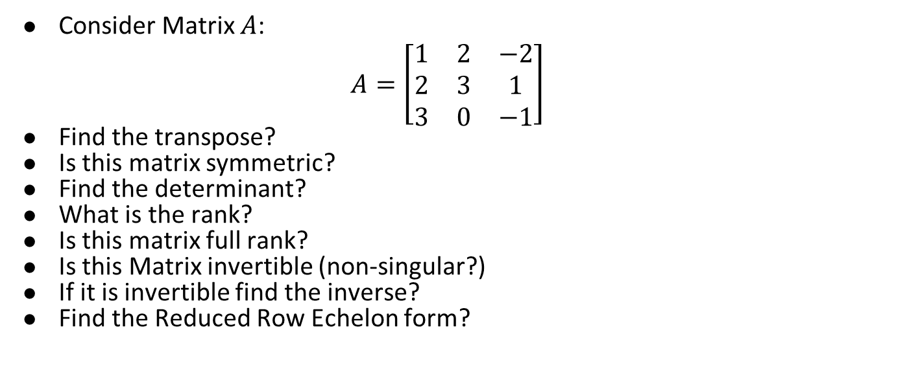
Example 1
Consider Matrix $A$:
$$A=\left[\begin{matrix}1 & 2 & −2 \\ 2 & 3 & 1 \\ 3 & 0 & −1\end{matrix}\right]$$
Find the transpose?
Is this matrix symmetric?
Find the determinant?
What is the rank?
Is this matrix full rank?
Is this Matrix invertible (non-singular?)
If it is invertible find the inverse?
Find the Reduced Row Echelon form?

Slide 14
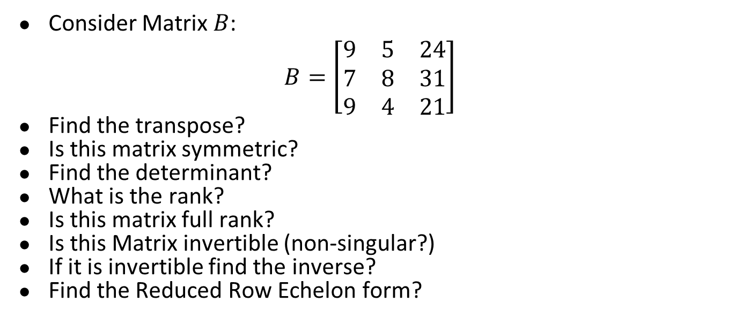
Example 2
Consider Matrix $B$:
$$B=\left[\begin{matrix}9 & 5 & 24 \\ 7 & 8 & 31 \\ 9 & 4 & 21\end{matrix}\right]$$
Find the transpose?
Is this matrix symmetric?
Find the determinant?
What is the rank?
Is this matrix full rank?
Is this Matrix invertible (non-singular?)
If it is invertible find the inverse?
Find the Reduced Row Echelon form?

Slide 15
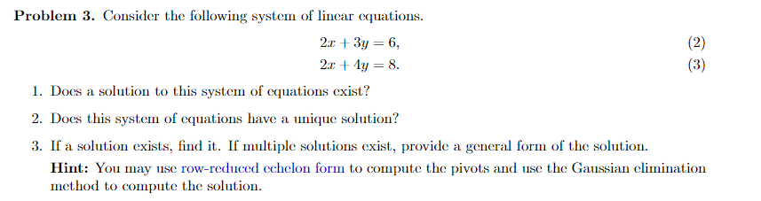
Homework Problem
Let’s go over a problem from HW 4

